Slide 1
SALES PREDICTION USING MACHINE LEARNING
Submitted by:
C. KEERTHIVASAN

Slide 2
AGENDA
TABLE OF CONTENTS
PROBLEM STATEMENT
PUPOSE OF THE PROJECT
01.
02.
Describes the problem that we are trying to solve by this project.
Why did we select this project.
DATA SET DETAILS
EDA
03.
04.
Details of analyzed data set.
Details of algorithms, logics and visualizations.
RESULTS
SUMMARY
05.
06.
Detailed explanation of obtained results.
Summary of obtained results.

Slide 3
We have to predict the sales volume of the goods based on item type, region, quantity and day of the week.
PROBLEM STATEMENT

Slide 4
SALES OPTIMIZATION
PURPOSE
Optimize sales by identifying peak days, region and category .
Purpose of the project
FOCUSED MARKETTING
Find out regional target market and category to use as inputs for marketing campaigns and obtain maximum results.

Slide 5
DATASET DETAILS
Details of dataset and field descriptions.

Slide 6
This dataset has been taken from real sales database.
This dataset contains 100,000 rows and 15 columns.
The following are the list of the variables.
State
City
SalesOrderDate
SalesOrder
SalesPerson
CustomerID
CustomerName
ItemType
ItemCategory
ItemSubcategory
Brand
ItemCode
Qty
NetAmount
GrandTotal

Slide 7
EXPLORATORY DATA ANALYSIS
In the initial dataset there were 470K records. So it was very complicated to perform EDA on the dataset.
To overcome that we randomized the data and taken 100K records and Dropped some columns.

Slide 8
VISUALIZATION

Slide 9
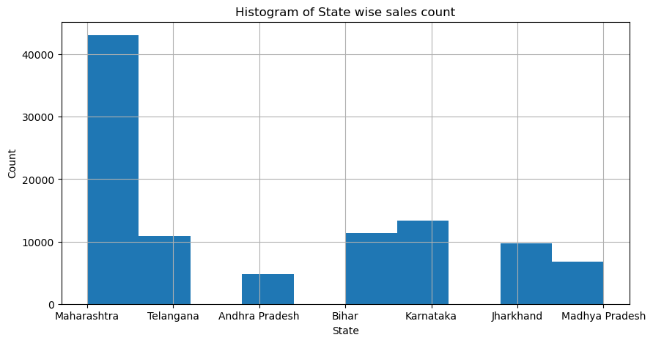
Histogram of State wise sales count
DFDFDFDFDFD

Slide 10
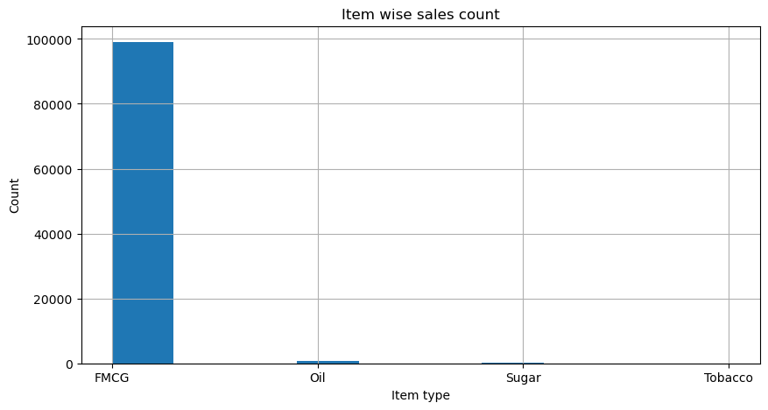
Histogram of Item wise sales count
DFDFDFDFDFD

Slide 11
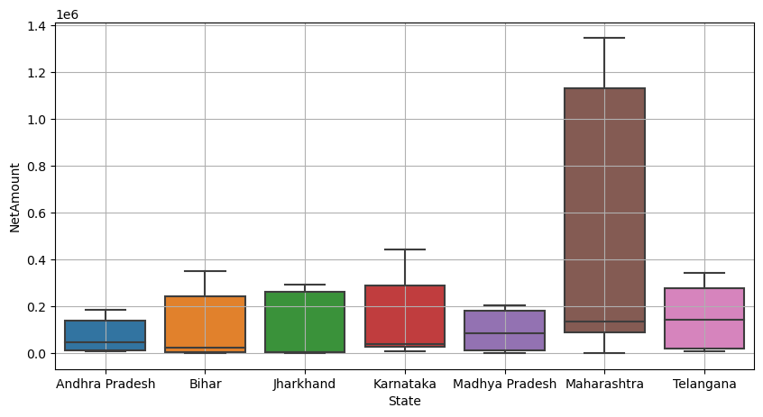
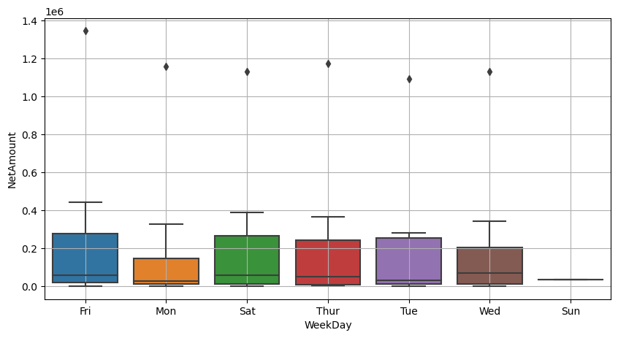
Scatter Plots
DFDFDFDFDFD

Slide 12
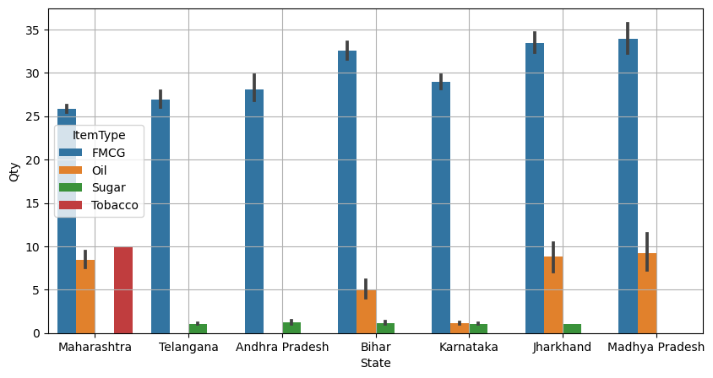
State-ItemType vs Qty
DFDFDFDFDFD

Slide 13
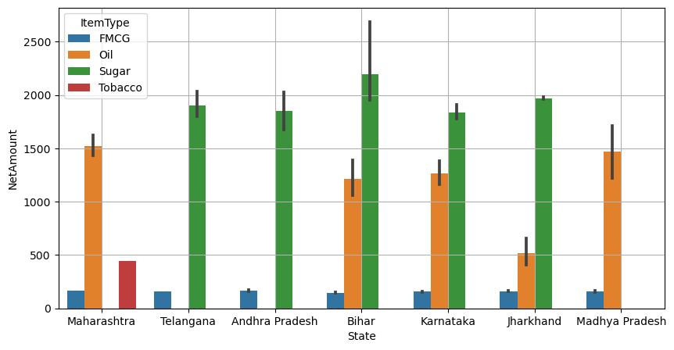
State-ItemType vs NetAmount
DFDFDFDFDFD

Slide 14
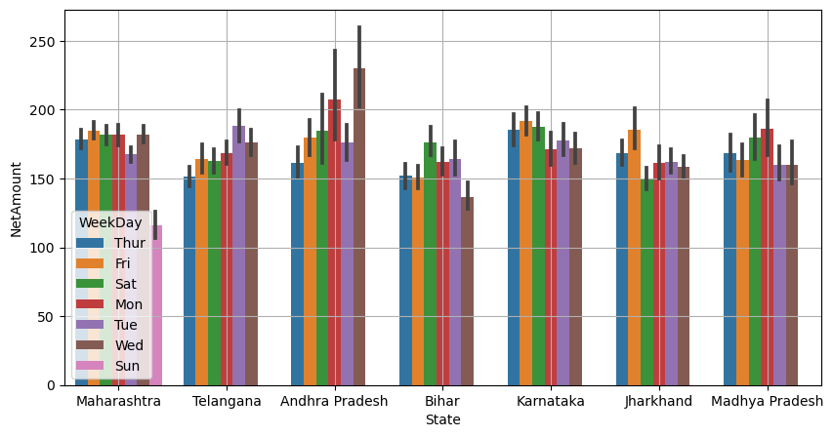
State-WeekDay vs NetAmount
DFDFDFDFDFD

Slide 15
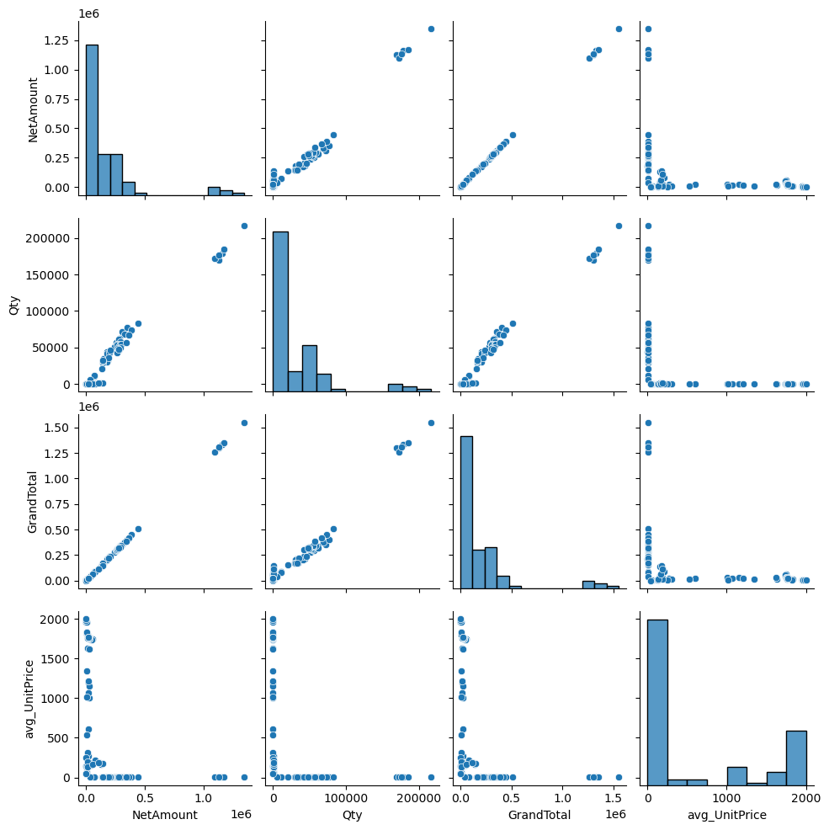
Pair Plot
DFDFDFDFDFD

Slide 16
RESULTS

Slide 17
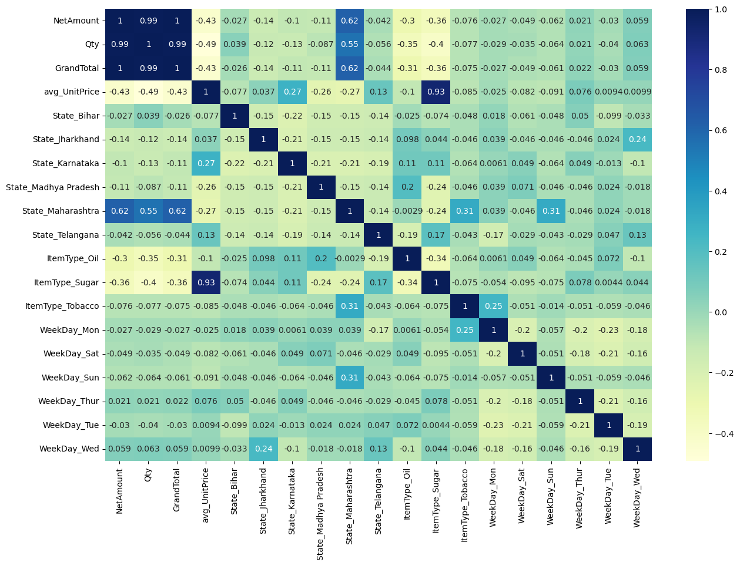
Heatmap Co-relation coefficient
DFDFDFDFDFD

Slide 18
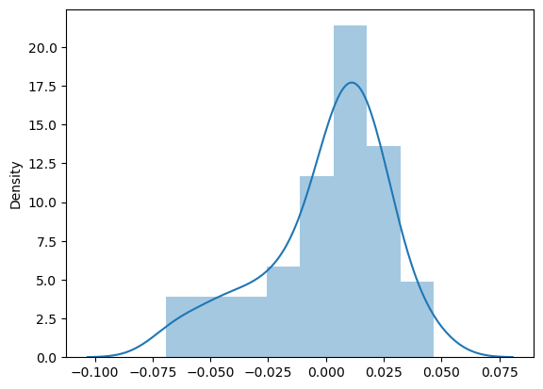
Residual Analysis of the train data
DFDFDFDFDFD

Slide 19
Maharashtra is top state in-terms of total number of sales.
FMCG is the most selling category.
Bihar is top sugar consumer state.
Top selling day in Andrapradesh is Wednesday.
SUMMARY
Some valuable insights from result

